Slide 1


Slide 2



Slide 4
Objectives
Demonstrate the execution of Advanced I/O code within an Integrated Development Environment (IDE)
Create a bespoke 3D mechanism controlled by Arduino Code

Slide 5
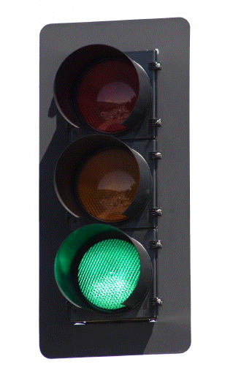
Arduino Challenge
Based on your knowledge of Arduino, build a traffic light system that is activated by a single button press.

Slide 6
Arduino Challenge
Now that you are familiarized with simple push button controls, we will look at other input/output controls that will allow us to create custom mechanisms.
Many of these I/O controls work in a similar manner but use different mechanisms to operate.

Slide 7
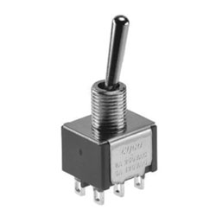
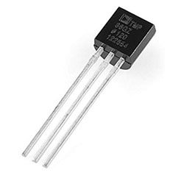
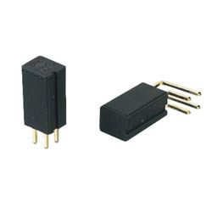
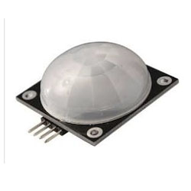
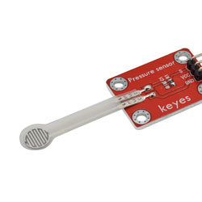
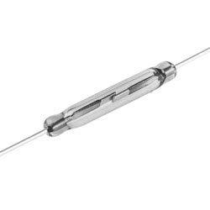
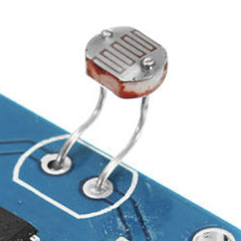
Arduino Challenge

Slide 8
Arduino Challenge
Controlling a Light with
Pulse Width Modulation (PWM)
Creating a Dimmable Light using the Delay Function
LED flickering can be caused by the system waiting to read a sensor, use analog pins 9, 10, 11 analogWrite()
Notes:
While experimenting, you will see that blinking the LED by putting delays
in your code is a bit inconvenient, because as soon as you want to read a
sensor or send data on the serial port, the LED will flicker while it’s waiting
for you to finish reading the sensor. Luckily, the processor used by the
Arduino board has a piece of hardware that can very efficiently blink three
LEDs while your sketch does something else. This hardware is implemented
in pins 9, 10, and 11, which can be controlled by the analogWrite()
instruction.

Slide 9
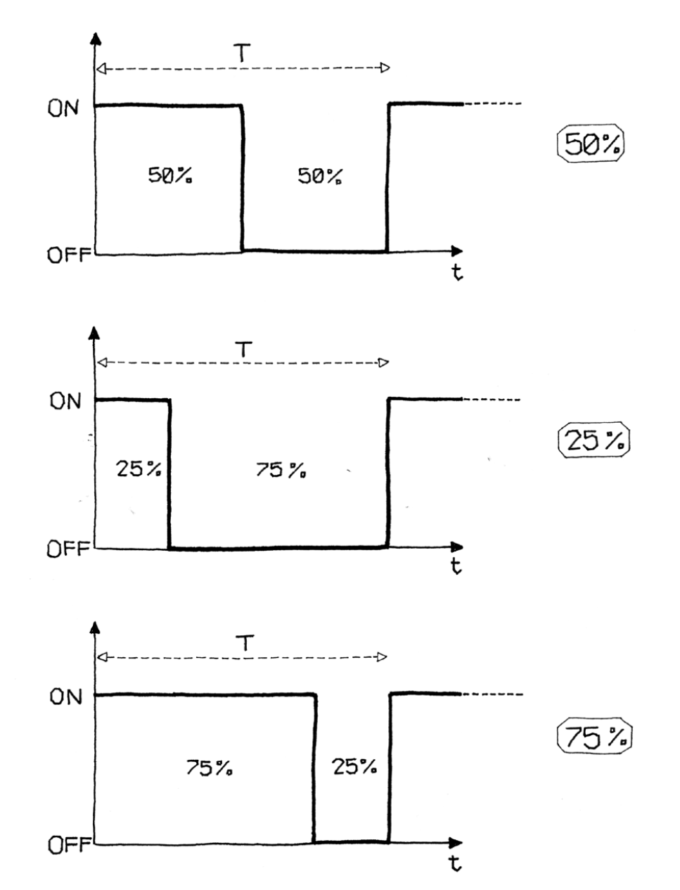
Arduino Challenge
For example, writing analogWrite(9,128) will set the brightness of an LED connected to pin 9 to 50%. Why 128? analogWrite() expects a number between 0 and 255 as an argument, where 255 means full brightness and 0 means off.
With the three analog output ports you have the ability to create any LED colour, why?
Notes:
While experimenting, you will see that blinking the LED by putting delays
in your code is a bit inconvenient, because as soon as you want to read a
sensor or send data on the serial port, the LED will flicker while it’s waiting
for you to finish reading the sensor. Luckily, the processor used by the
Arduino board has a piece of hardware that can very efficiently blink three
LEDs while your sketch does something else. This hardware is implemented
in pins 9, 10, and 11, which can be controlled by the analogWrite()
instruction.

Slide 10
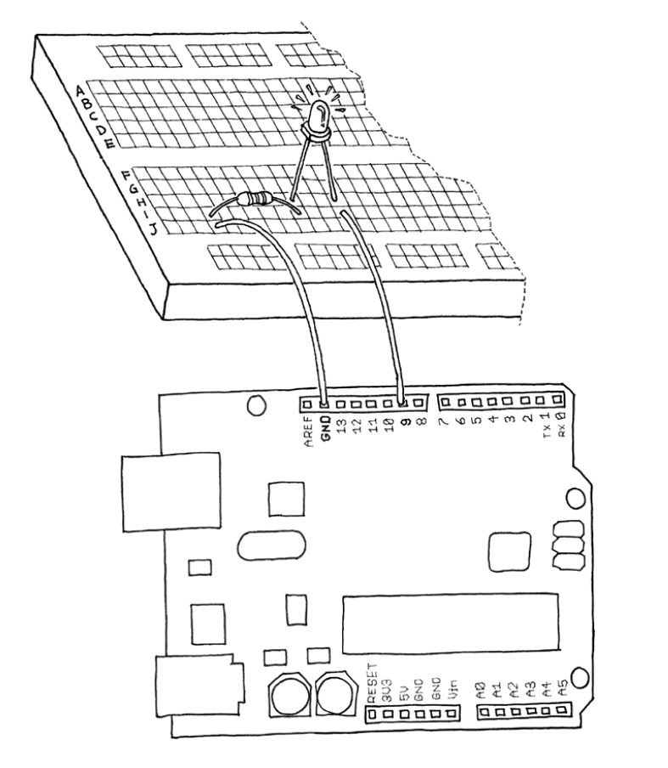
Arduino Challenge
Test this for yourself…
Follow the diagram and code provided online
Use a 270 ohm resistor (red violet brown)

Slide 11
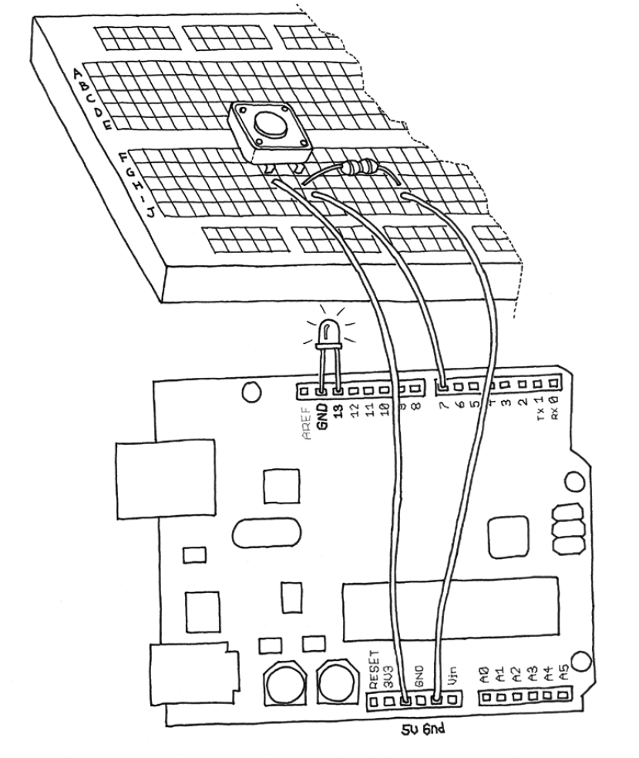
Arduino Challenge
Turn on the LED on by pressing the button, if held down the brightness changes.
Use the diagram as a starting guide.

