Slide 1
Presentations
Notes:
Notes here Notes here Notes here Notes here Notes here Notes here Notes here Notes here Notes here Notes here Notes here Notes here Notes here Notes here Notes here Notes here Notes here Notes here Notes here Notes here Notes here Notes here Notes here Notes here Notes here Notes here

Slide 2
What is a Presentation?
The process of presenting the content of a topic to an audience

Slide 3
What is PowerPoint?
It allows impressive presentations to be produced with ease
It can be used for on-screen shows, overhead projector shows, producing slides, and web pages
They can include formatted text, pictures, charts, graphs, sound, film clips, and information from the Internet
It can also produce presentation notes, hand-outs, printouts and outlines of text

Slide 4
Do
Smile
Move
Test your setup before the presentation
Consider your audience
Keep it simple
Be yourself!
Update your slides for each presentation
Place logo in bottom right-had corner

Slide 5
Don’t
Forget to turn off your screen saver
Beeping laptop
Speak too quickly
Overuse animation
Use too many bullets and fonts
Use a font that’s too small
Place too many words on a slide
Use red lettering – red = negative

Slide 6
Spelling
Spelling is important
Incorrect spelling can be embarrassing
Don’t depend on the spell checker
Ask someone to proof read your slides

Slide 7
Basic Rules for Presentations
Contrast is important
For paper…
  Dark text on a light background

Slide 8
Basic Rules for Presentations
For projection…
  Light text on a semi-dark background
  The eye is attracted to the light on the screen

Slide 9
Basic Rules for Presentations
Stick with a single background
  The background is the stage for your information
  Set the stage and leave it alone!

Slide 10
Basic Rules for Presentations
Don’t try to dazzle the audience with graphics or style…but with the information
The medium is not the message
The information is the message

Slide 11
Basic Rules for Presentations
Balance
Do not center bullet points
It makes the text ragged
And hard to read and follow with your eyes

Slide 12
Basic Rules for Presentations
Balance
Generally, left-justify bullets
This keeps things neat
and easy to follow

Slide 13
Basic Rules for Presentations
Balance
Centered graphics leave little room for text

Slide 14
Basic Rules for Presentations
Balance
Place graphics off-center
More room for text
Better balance
More pleasing to the eye
Left placement leads the eye to the text

Slide 15
Use Restraint With Fonts
Employ only a few, stick to familiar fonts
Stay away from gimmicky fonts unless for a theme
Keep type sizes consistent
DON’T USE ALL CAPS – too hard to read

Slide 16
Choose Fonts Wisely
Italics are more difficult to read
Use bold when you want some words to stand out
Font size
  Easy to read (18 pt)
  Easy to read (24 pt)
  Easy to read (32 pt)
  Easy to read (48 pt)

Slide 17
Avoid Text Overload
Having too much text on the screen can defeat the purpose of using PowerPoint. The slides begin to look like a jumble of text, making slides difficult to read and unrecognizable from each other. People will either try to read everything or copy everything down or they will lose interest. List only the key points. If you have more info to include use more slides or create handouts

Slide 18
Basic Presentation Mistakes
Too much information
Reader gets distracted
Audiences are much more receptive to the spoken word

Slide 19
Basic Rules
Keep it simple
Make bulleted points easy to read
Keep text easy to understand
Use concise wording
Bullets are focal points
Presenter provides elaboration
Keep font size large

Slide 20
Basic Power Point Guidelines
Builds the presentation… don’t give them too much info at once
Stick with the same transition
Be creative but leave some colour choices to professionals
Six words per line
Six lines per page

Slide 21
Choosing a Color Scheme
Stick with power point defaults.
What may look good on your computer may be unreadable in the classroom.
Remember to use strong, contrasting colours

Slide 22
Use Contrasting Colors
Light colours on dark background
Dark colours on light background

Slide 23
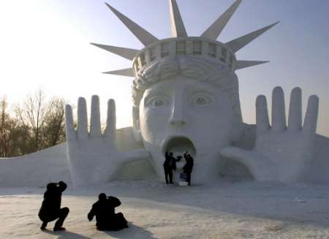
Clip Art & Graphics
A few excellent graphics are better than many poor ones
Photographs can be powerful
Use sparingly!

