Slide 1
Poster Presentations
Guidelines
Notes:
http://lorien.ncl.ac.uk/MING/dept/Tips/present/posters.htm

Slide 2
Keep the material simple
Make full use of the space, but do not cramp a page full of information – it could look messy
Be selective when showing results – present only the main facts

Slide 3
Use colours sparingly and with taste
Colours should be used only to emphasise and to add interest
Avoid bright colours, ie bright pink, bright yellow, bright green, etc
Pastel shades convey feelings of calm
Bright colours conjure an image of conflict and disharmony

Slide 4
Background colours
Use background and foreground colours that complement each other
It’s best to keep the background light – dark background will cost more to print and is harder to read
Avoid gradient fills – they can look tatty when printed

Slide 5
Fonts
Too many font types distract, especially when they appear on the same sentence
Use fonts that are easy on the eye
  This is Times Roman
  This is Arial

Slide 6
Fonts
Headings should appear larger than the other text, but not too large
Do not use all UPPER CASE type – makes it difficult to read

Slide 7
WHAT DO YOU THINK OF THIS LINE WHERE ALL THE CHARACTERS ARE IN UPPER CASE?
What do you think of this line, where only the first character of the first word is in upper case?

Slide 8
Fonts
Do not use a different font type to highlight important points – it loses the fluency and flow of the sentence.

Slide 9
In this sentence, I want to emphasise the word ‘emphasise’
In this sentence, I want to emphasise the word ‘emphasise’

Slide 10
Spelling
There is nothing more amusing or annoying than spelling mistakes
  It gives the impression that you are:
    Careless
    Not bothered
    Not worthy of a high assessment mark

Slide 11
Common Errors
Incorrect | Correct
Please except the gift | Please accept this gift
He’s alright after his fall | He’s all right after his fall
He refused to take my advise | He refused to take my advice
Put the bag back in it’s place | Put the bag back in its place
The car past the train | The car passed the train
We spent a quite evening reading | We spent a quiet evening reading

Slide 12
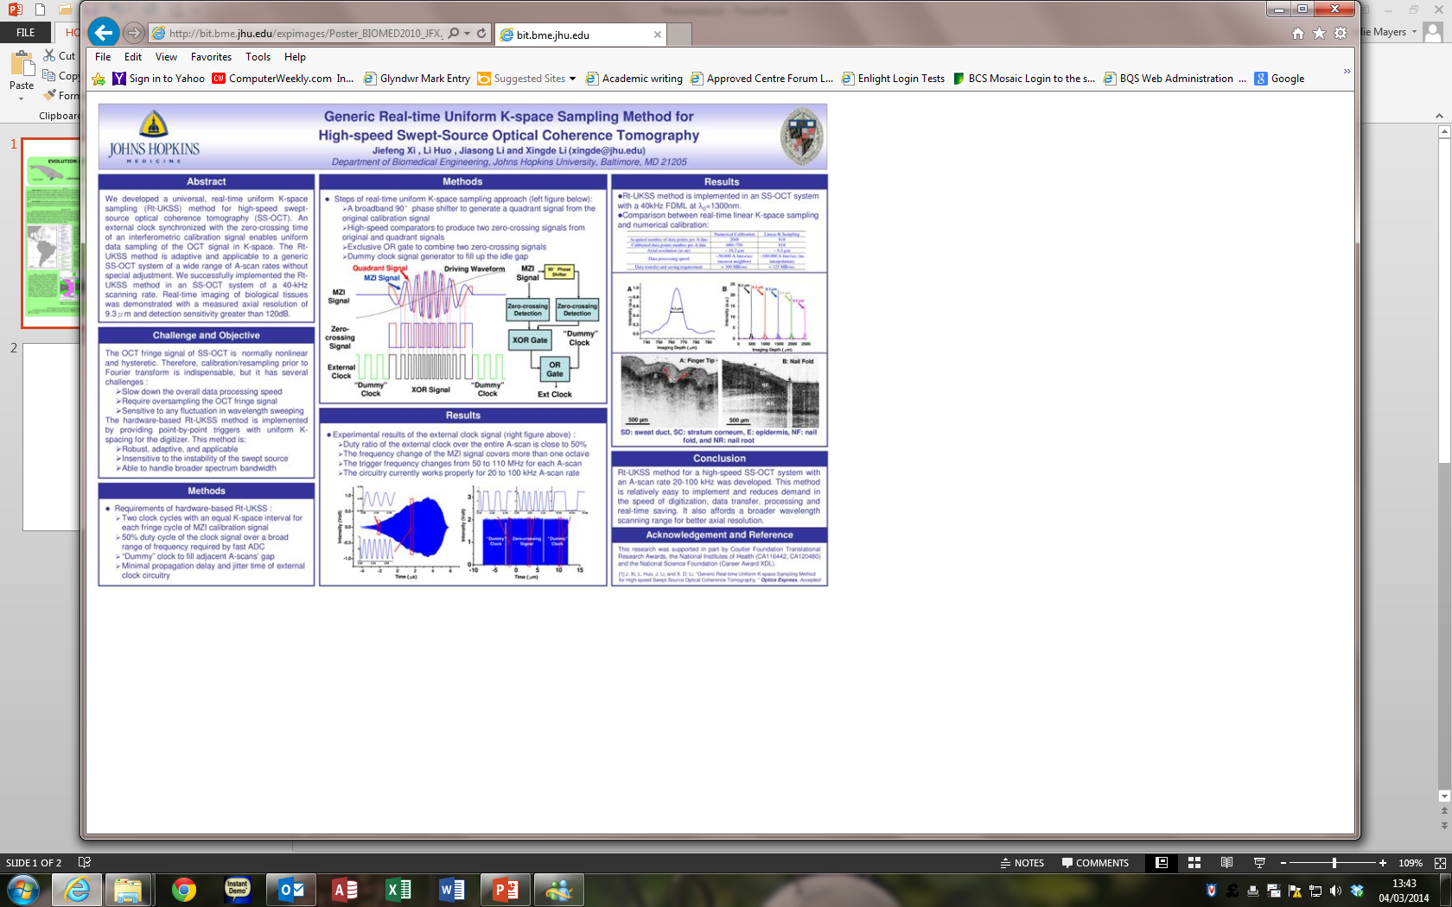

Slide 13
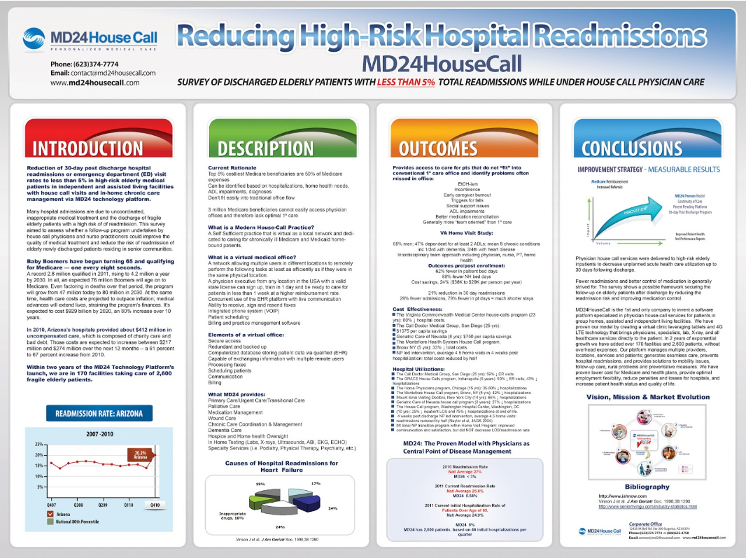

Slide 14
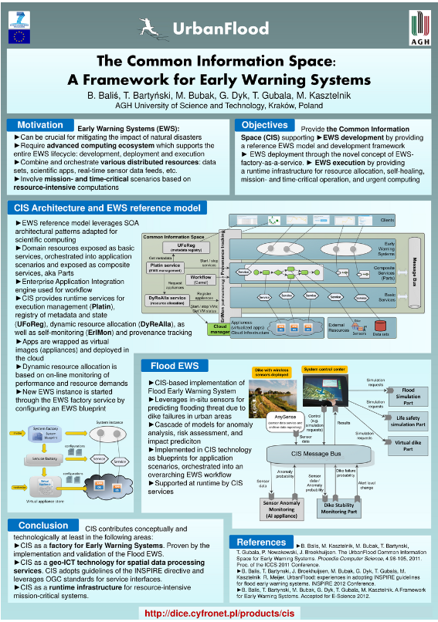

Slide 15
