Slide 1


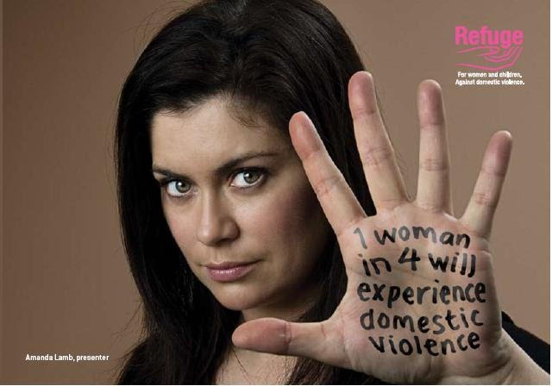
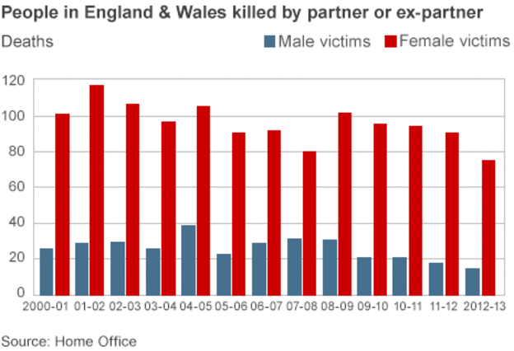

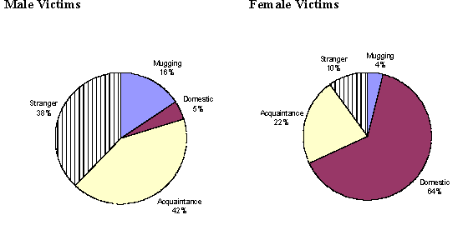
Your name | Teacher’s name | School
statistics
Results
Each year around 2.1m people suffer some form of domestic abuse - 1.4 million women (8.5% of the population) and 700,000 men (4.5% of the population) (Safelives. 2015b)
Each year more than 100,000 people in the UK are at high and imminent risk of being murdered or seriously injured as a result of domestic abuse (SafeLives,2015b),
Women are much more likely than men to be the victims of high risk or severe domestic abuse: 95% of those going to Marac or accessing an Idva service are women (SafeLives (2015b),
In 2013-14 the police recorded 887,000 domestic abuse incidents in England and Wales (SafeLives (2015a),
Seven women a month are killed by a current or former partner in England and Wales ²
130,000 children live in homes where there is high-risk domestic abuse (SafeLives (2015a)
62% of children living with domestic abuse are directly harmed by the perpetrator of the abuse, in addition to the harm caused by witnessing the abuse of others (Caada (2014),
On average high-risk victims live with domestic abuse for 2.6 years before getting (helpSafeLives (2015b)
85% of victims sought help five times on average from professionals in the year before they got effective help to stop the abuse (SafeLives (2015b),
Introduction
Domestic violence is an incident or pattern of events involving violence, controlling or threatening behaviour. Its abuse of those aged 16 or over who are or have been family members or intimate partners of any gender or sexuality (Safelives, 2015a)
Conclusion
I discovered that women and children are more susceptible to domestic violence in England and wales than men this does not mean that men do not undergo abuse them selves but women and children are more at risk.
Facts and stats about domestic violence
Statistics show that the amount of violence recorded by the authorities each year. However the problem is much higher as most cases are not reported, this is due to most victims never speaking of their abuse so the crimes are never recorded. This is why Safelives (2015a) use the national database of domestic violence cases in the UK dating from 2009 to now.
References
SafeLives, (2015a), Getting it right first time: policy report. Bristol: SafeLives.
SafeLives (2015b), Insights Idva National Dataset 2013-14. Bristol: SafeLives.
Caada (2014), In Plain Sight: Effective help for children exposed to domestic abuse. Bristol: Caada.

