Slide 1
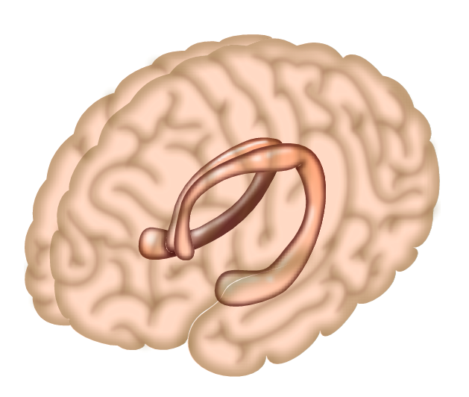

Discovering PTSD Laura Taylor
Introduction
Treatment-EMDR
Parts of the brain affected
PTSD is a metal health disorder were essentially a memory filing error that is caused by a traumatic event i.e. sexual assault, warfare, RTA. Symptoms include:
Depression
Panic attacks
Substance misuse, most commonly alcohol misuse
Irritability towards friends, family and strangers
Difficulty sleeping
Reliving memories of traumatic events, leading to sweating, headaches and nausea
Feeling detached from loved ones
Feelings of paranoia
Social anxiety and becoming isolated
Symptoms last for more than 4 weeks.
PTSD can also occur in children as well as adults.
EMDR – Eye movement desensitizing and reprocessing is a treatment developed by Francine Shapiro. When walking through the woods she realised that certain eye movements reduced the intensity of disturbing thoughts conducting a scientific study in 1988 with trauma victims Shaprio discovered that with doing 'side to side' eye movements it helped ease symptoms and reduce flash backs realising EMDR mimics REM therefore helping the hippocampus process the traumatic event. (Shaprio, 1989)
The part of the brain involved in memory and emotion is the Hippocampus there is one either side of the brain. A study showed that patients with PTSD showed their Hippocampus was smaller compared to those without PTSD. The Hippocampus is unable to process trauma with REM naturally this is were treatments are needed.
Treatment-CBT
Cogitative Behavioural Therapy has pros and cons as researched a therapist can only help so much and the patient needs to able to but all in the sessions which is not always possible depending on the patients severity of mental health. There are a few different way in which CBT can take place
one to one sessions
group session
self help
computer program known as CCBT
(nhschoices.co.uk)
Conculsion
History
60% of men and 50% of women experience a traumatic events in there lives women are more susceptible to developing PTSD, shows as 10% of women and 4% of men develop PTSD. children also can develop PTSD stats show that 8% are girls and 2.3% are boys. This information can be argued against as children may not be diagnosed until adulthood, also people may not seek advice with symptoms they experience and get undiagnosed 7-8% of population will have PSTD at some point in life. 8 million adults a year will suffer PTSD, this however is just a small number compared to the amount of people will experience a trauma. (ptsd.va.gov, 2016)
PTSD sometimes is considered to be a fairly new diagnostic however it dates back to the history of the war previously known as shell shock, traumatic war neurosis, combat fatigue, battle stress and gross stress reaction.
PTSD was first recorded in the official Diagnostic and Statistical Manuel of Mental Disorders (DMS)I which was published in 1952 by the American Psychiatric Association however PTSD as is known know was not officially recognised until 1980.
Andreasen, N.C. (2010) Post Traumatic Stress Disorder: A history and a critique. Animals of the New York academy of Sciences. Vol. 1208, Pages 67-71.
Shaprio, F– Efficiancy of thde eye movement desensitisation procedure in the treatment of traumatic memories journel of traumatic stress vol 2, issue 2 pages 199-223
progress in neuro-psychopharacology and biological psychiatry vol 34, issue 7 pages 1181-1188.
www.ptsd.va.gov
www.nhschoices.co.uk

