Slide 1

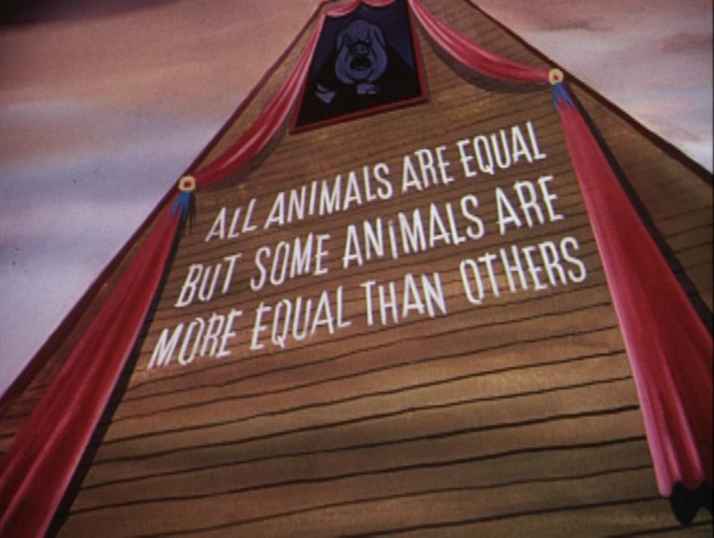
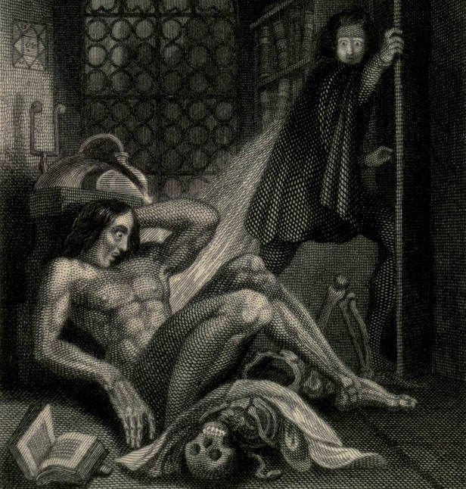
How Literature is used to expose common issues
Kelsey Cowling
Introduction
Some Other Examples
Literature are one of the factors that creates a unique culture in today’s world. However, as well as writing stories to entertain their readers, writers can also use their works to explore or expose issues around our lives. As a result, readers can be manipulated to think from the writer’s POV, inspiring them to take action for a better change or to see the world in a different, more aware light. If you read between the lines, you might have already been enlightened before by the influence of literature.
.Of Mice And Men by John Steinbeck- The conditions of the Great Depression and the futility of achieving ‘The American Dream.’
.Game Of Thrones by George R. R. Martin- Human attitudes towards politics, sex, love, culture and prejudice.
. High-Rise by J. G. Ballard- Humanity degrading to the level of early man with the loss of modern privileges and ideologies.
. Fight Club by Chuck Palahniuk- The restricting influences of Consumerism and the male desire to regain the traditional masculine image.
. 1984 by George Orwell- The power the Government has over the population with the use of manipulation and controlling their sense of purpose.
Example 1: Animal Farm
This novella by George Orwell is about a group of farm animals who unite to drive away their human masters and create an improved society for themselves. However, it all quickly degrades when the pigs seize all the power for themselves, while all the other animals suffer, making them realise that the pigs are no better than the humans. Here, Orwell exposes the corruption of Communism in Russia and uses the animals and the farm setting to cover his Socialist views:
. The prize boar Old Major is the first animal to suggest the idea of this new society, similar to Lenin who inspired the Communist party and Karl Marx with his political visions.
. Napoleon is a ruthless leader who eliminates his opponents using his trained guard dogs, gets rid of his rival, Snowball and forcing the animals to work while executing those who refuse to follow. He is like Stalin who exiled his rival, Trotsky and executed soviets who were classed as ‘enemies of the people.’
. Snowball is one of the pigs who is an eloquent and passionate speaker, winning over the animals before Napoleon drives him away. He represents Trotsky who had the same skills before he was exiled and assassinated.
. The animals in the farm are the working class, naïve to believing the empty promises given to them by their leaders. Boxer the carthorse is the best example as his motto is ‘I will work harder’ (Orwell, 1946) and ‘Napoleon is always right.’ (Orwell, 1946) Once he has reached his usefulness, the pigs dispose of him by sending him to be slaughtered, showing how much the working classes were exploited under Communism, despite the promises they were granted.
Orwell exaggerates the abuse of power by the pigs. They steal the best food for themselves, never actually participate in any manual labour, use Snowball as a scapegoat for disastrous events around the farm and lie to them through a pig named Squealer, representing propaganda. They break their own commandments by changing them slightly to suit their own benefits, eventually changing it to ‘All Animals are equal, but some Animals are more equal than others.’ (Orwell, 1946) In the end, the animals can’t define the pigs from the humans.
Example 2: Frankenstein
Mary Shelley’s iconic novel is about the scientist Victor Frankenstien creating a monster out of dead body parts and animating it with chemicals and electricity. However, he is horrified at his creation and after a number of tragedies in his family caused by the Monster, he sets out on an obsessive quest for vengeance. But the novel has more to it as it also includes issues around human nature:
. Mankind are very curious, especially concerning scientific knowledge. But Shelley proves that knowledge can be dangerous if exploited for your own benefit, such as Victor seeing if he could play God by creating life, ‘I will pioneer a new way, explore unknown powers.’ (Shelley, 1818) This leads to devastating consequences like his family, friends and wife being killed by the Monster, the Monster suffering from rejection and loneliness and both of them dying at the end.
. The Monster is a victim of prejudice because people judge him on his appearance and they run away or beat him if he approaches. Even Victor shuns and disowns him, despite him being the Monster’s ‘father’ and his creation having a kind and gentle nature like a child. He even calls himself ‘an abortion.’ (Shelley, 1818) This injustice leads the Monster to retaliate by violence and murder to punish Victor for creating him.
. The Monster wants to make friends but as society rejects him, he is forced to live in isolation. When Victor creates him and tries to escape from his tragedies, he puts himself in isolation as well due to his obsession. It’s human nature that we feel comfortable with companionship and we’ll slightly degrade if we have none.
. Critics commonly agree that Victor is the ‘true’ monster. He refuses to take responsibility for his creation and puts him in isolation, enraging the Monster’s violent actions. He agrees to create a mate for him but destroys it before the Monster, causing his own wife to die. His intense desire to kill the Monster becomes an animalistic obsession, leading to his own death but before he dies, he demands to his new friend, Walton to do the deed for him. Anyone could become a ‘monster’ like him.
Conclusion
These are just two examples of how literature exposes common issues that still affect us, even today like politics, historical events and ourselves as human beings. Yet literature has been used as a tool to make people think in the way the author wants them to like sharing their ideologies with their readers or manipulating them if used for propaganda. Writers are always sharing their ideas and thoughts with readers, most of them clear, others well hidden. See what you can find if you read another book and think about how the author communicates to you.
Bibliography and references
Orwell, G. (1946) Animal Farm, California: Harcourt Brace & Co.
Shelley, M. (1818) Frankenstein, London: Penguin

