Slide 1
Reflection
Sam Gibson

Slide 2
Learning Objectives
Clarify what is meant by reflection
Identify the key components of reflection
Use reflection to illustrate your personal and professional strengths

Slide 3

What is Reflection?
Notes:
Activity 1: Discuss in pairs what reflection means and use handout to list ideas/thoughts

Slide 4
Reflection is…
Reflection is the active process of witnessing one’s own experience in order to examine it more closely, give meaning to it and learn from it.
(Joy Amula, 2011)

Slide 5
Reflection involves…
3 Basic Elements:
Self-awareness: thinking of yourself, your experiences and your view of the experience (Returning to an experience)
Self-improvement: learning from those experiences and wanting to improve yourself (Evaluating experience)
Empowerment: putting you in control of behaving in a way that supports your learning (Attending to feelings)

Slide 6
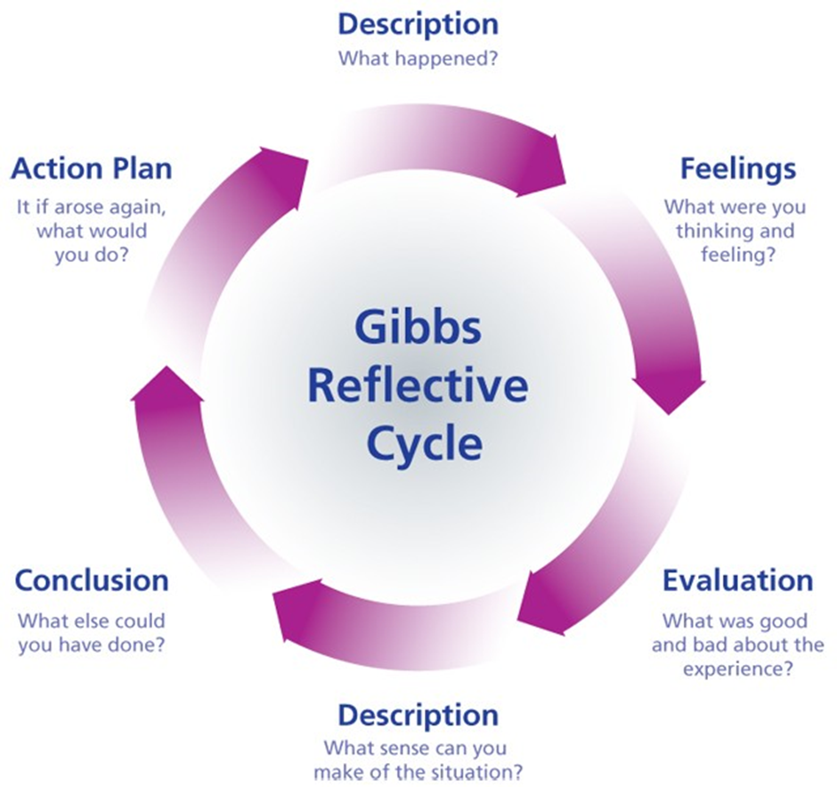
Gibbs Model for Reflection

Slide 7
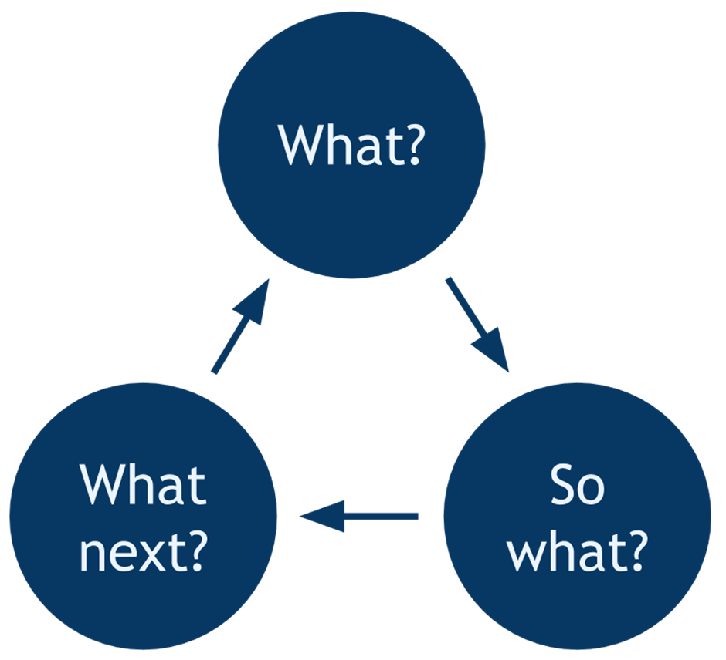
Rolfe’s Model of Reflection

Slide 8
Remember…
The ability to reflect on your experience and knowledge, and use that to make improvements, is a key part of university-level thinking and work.

Slide 9

Cake and Break…

Slide 10

Food for thought……
What happened during break?
What did you think when you were given cake?
How did you feel about it?
Did you enjoy it?
Could it have been nicer?
Is it a good idea to give learners cake?
What cake could we use next time?
Notes:
Discuss cake and relate it to Gibbs reflection model.

Slide 11
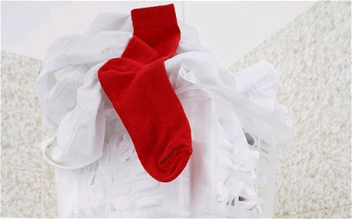
The Red Sock….

Slide 12
It’s turning Pink…..
I THINK I may have put a red sock in with the whites…
I have noticed it and stopped the machine (REACTED) - no guarantee it won’t happen again..
But What If….
I REFLECT on the situation, I think CRITICALLY and PLAN a method to stop it reoccurring

Slide 13
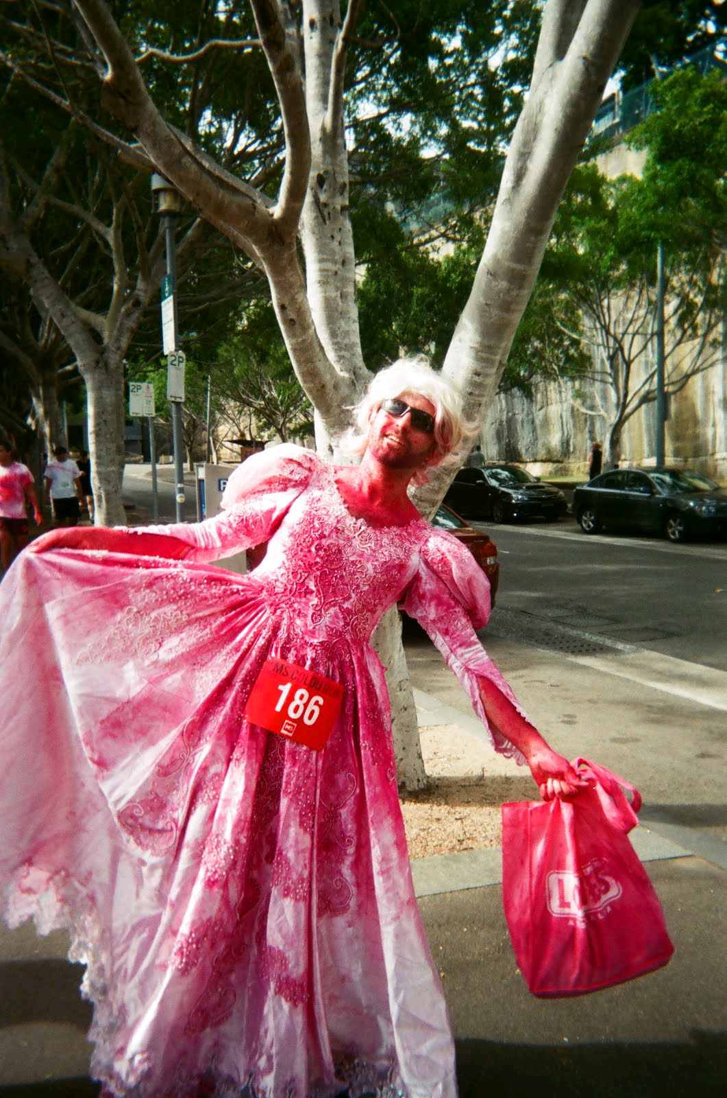
Trendsetter???

Slide 14
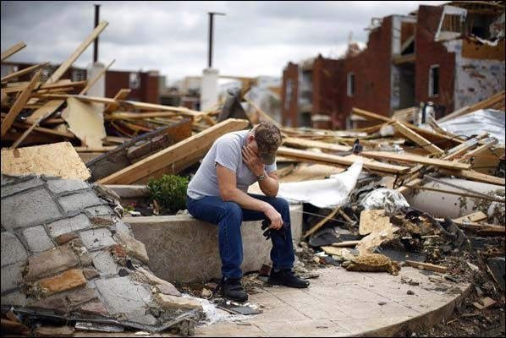
Reflective Writing
Notes:
Activity 2: Study the image shown and select the correct sentences to make a reflective piece of writing.

Slide 15
Reflective Writing
Reflective | Not Reflective
This image makes me feel so sad for the poor man sitting on the wall. He looks absolutely devastated by what appears to be a terrible storm. I wonder how he will rebuild his life? I wonder if he lost any family members in the storm? I remember watching a film once about a tornado and recall how scared I was. What would I do if I was in this situation? If I was there I would try to help him collect some of his belongings, maybe get him something to eat. Maybe people who see these kind of images will get together and come up with a plan to make stronger houses that do not fall apart like this. | A man is sitting on a wall outside what used to be a house. The man is wearing blue jeans, a grey tee shirt and a camouflage cap. There is debris everywhere and the houses look badly damaged. The man looks sad. He is sitting on a low concrete wall. The sky is cloudy. There is no one else in the picture.
Notes:
Discuss learners findings

